Slide 1
EPIC
Eukaryotic Promoter and transcription Initiation prediction Challenge
Challenge overview, rules and timeline
The Eukaryotic Promoter Database EPD's 40th anniversary symposium
Sep 04 2026, Geneva, Switzerland
Philipp Bucher

Slide 2
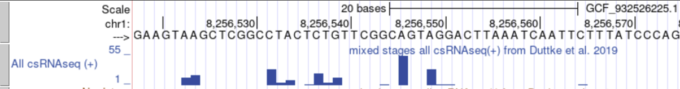
The challenge in a nutshell
Transcription starts at specific positions in the genome at different rates.
Technologies exist that capture transcription initiation events genome-wide at single base resolution.
The resulting data have the structure of a count histogram of transcription start sites (TSSs) along the genome.
Participants will receive TSS data for 80 % of the genome and are requested to predict TSS frequencies for the rest of the genome from the DNA sequence.
The evaluation will be strictly based on primary single-base TSS data
… not on derived annotation such as genomic intervals declared as promoters or TSS clusters inferred by downstream analysis software tools.

Slide 3
The challenge data
Capped small RNA-seq (csRNA-seq) data for five animal species from Sascha Duttke's lab (one tissue, 2-3 replicates)
csRNA-seq uniformly captures active RNA polymerase II initiation events from total RNA (Meyer et al. Nature 2026),
enables high-resolution mapping of transcription start sites and initiation rates of both stable RNAs (mRNAs and non-coding RNAs) and transient RNAs (enhancer, promoter-antisense, or primary micro RNAs).
sRNA-seq data (small RNA, capped and uncapped) are provided as controls (utility unknown, could help))

Slide 4
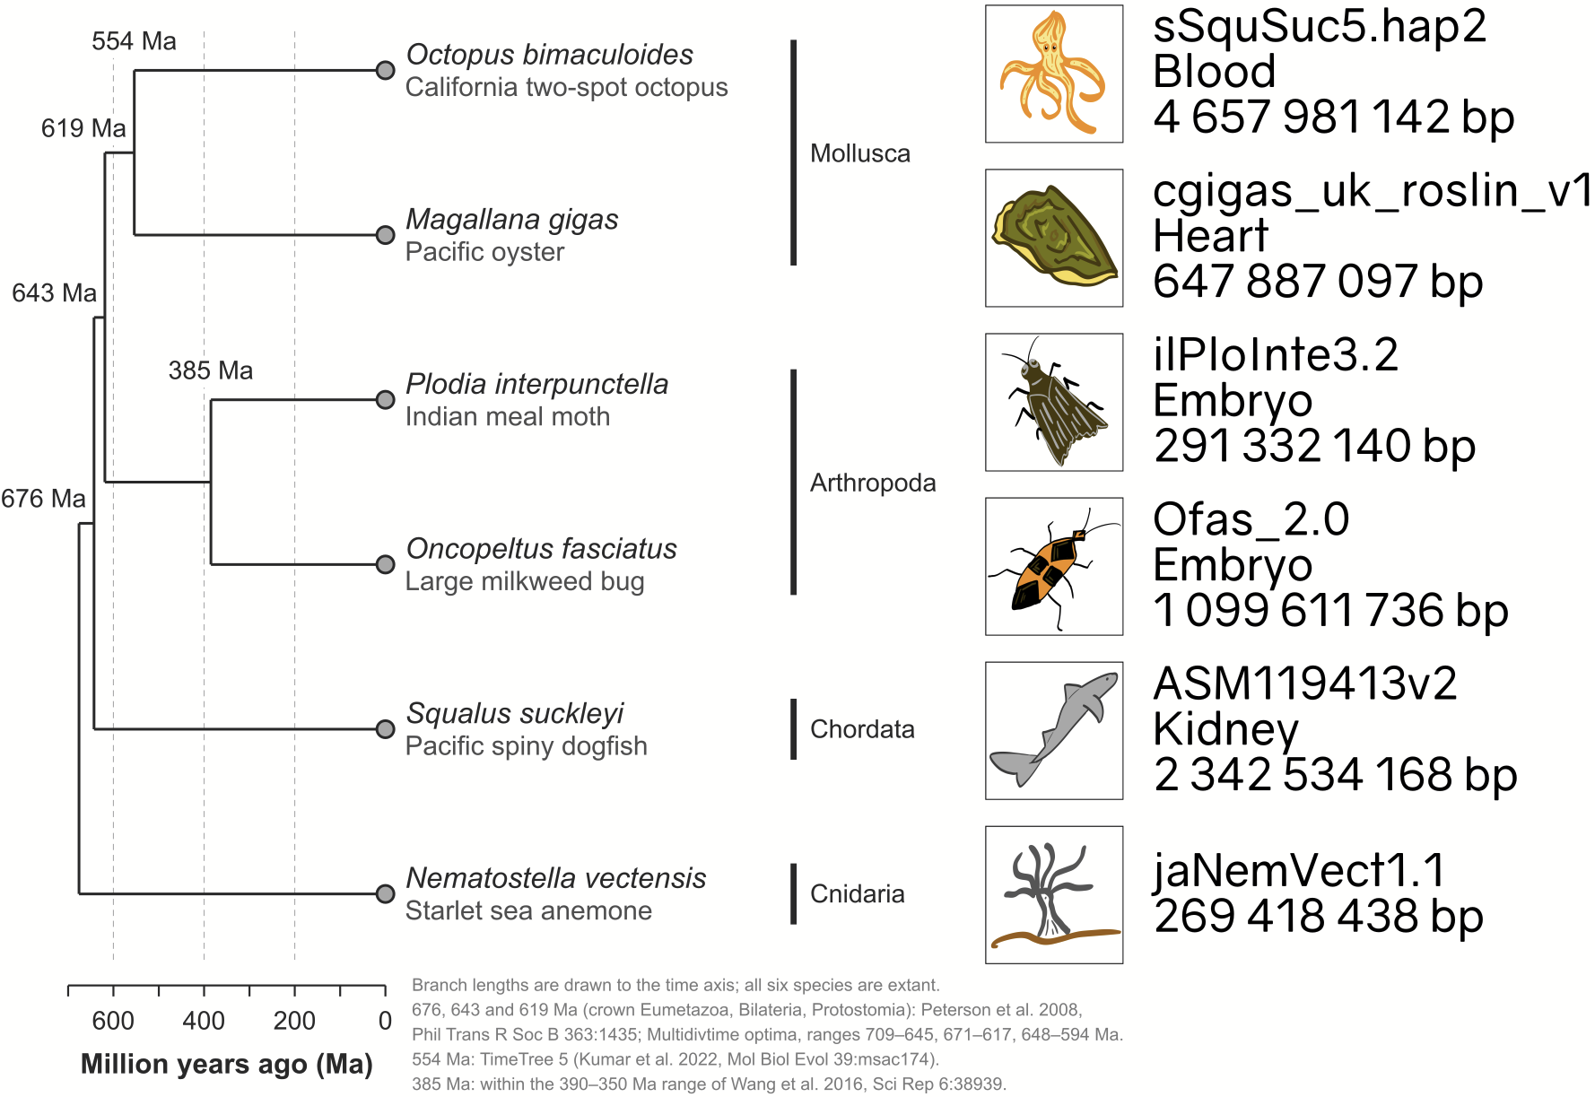
Species and genomes
Challenge genomes
Nematostella provided as toy and demo example
Public csRNA-seq data available from GSE135498

Slide 5
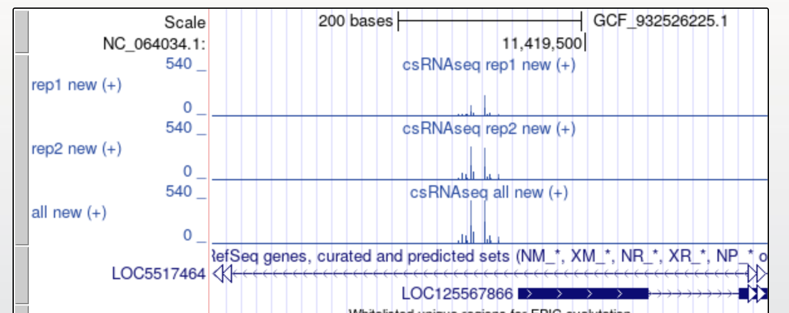
Nature of the data – TSS clusters
Oriented: Initiation on + and − strand are separate events, effective genome size twice as big
Regional effects: TSSs often occur as clusters, causes partly understood, some may be promoters or enhancers, other just open chromatin.

Slide 6
Nature of the data – large dynamic range
Sparse: > 99.9 of genomic positions not used as TSS
Large dymamic range: top 1000 positions make up 50% of all TSS counts
Count statistics for the combined replicates of in Nematostella.
Counts per position | # of positions | # of counts | % positions | % counts
all | 537175922 | 10474611 | 100% | 100%
> 0 | 421019 | 10474611 | 0.0784% | 100%
>10 | 43818 | 9676190 | 0.0082% | 92.37%
> 100 | 8339 | 8601837 | 0.0016% | 82.12%
> 1000 | 1387 | 6717198 | 0.00026% | 64.12%

Slide 7
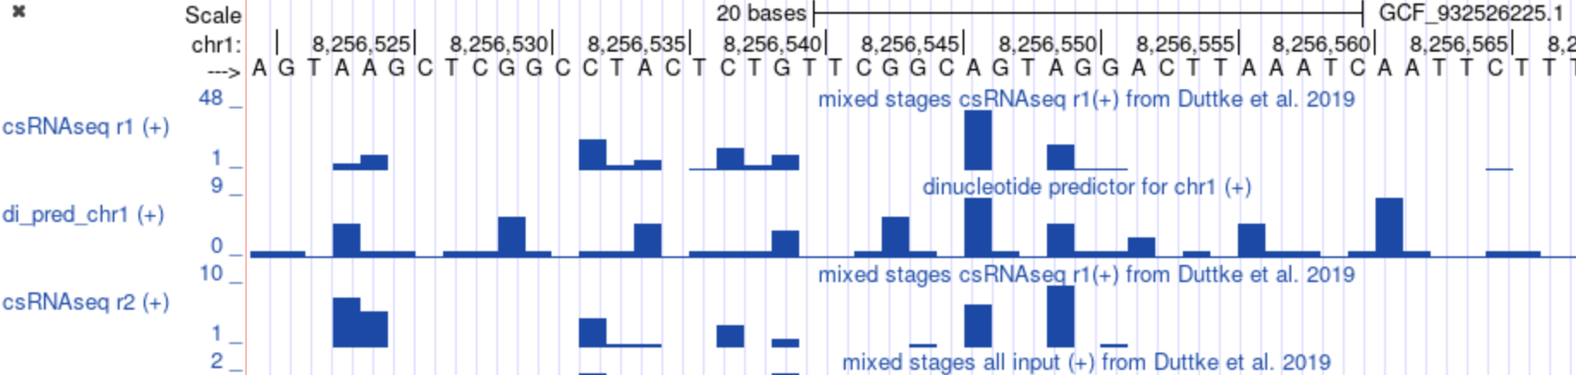
Baseline and Replicate predictors
Basic baselines serve as sanity checks for evaluation pipelines
More advance baselines indicate progress over state-of-the art
Replicate "top lines" provide upper limits of prediction accuracy.
Example of a basic baseline: dinucleotide scores
(numbers reflect initiation frequency at second base of dinucleotide)
AA | AC | AG | AT | CA | CC | CG | CT | GA | GC | GG | GT | TA | TC | TG | TT
1 | 0 | 1 | 0 | 9 | 1 | 6 | 1 | 1 | 3 | 0 | 1 | 5 | 1 | 4 | 0
Genome browser view of dinucleotide and replicate predictors

Slide 8
Baseline and Replicate predictors
Numerical data
rep1 0 0 0 6 13 0 0 0 0 0 0 0 25 4 9 0 1 18 5 12 0 0 0 0 0 0 48 0 0 20 1 1 0 0 0 0 0 0 0 0 0 0 0 0 0 1 0 0
dinuc 1 1 0 5 1 1 0 1 1 6 1 0 1 1 5 0 1 1 1 4 0 0 1 6 1 0 9 1 0 5 1 1 3 0 1 0 5 1 1 0 1 9 1 0 0 1 1 0
rep2 0 0 0 8 6 0 0 0 0 0 0 0 5 1 1 0 0 4 0 2 0 0 0 0 1 0 7 0 0 10 0 1 0 0 0 0 0 0 0 0 0 0 0 0 0 0 0 0
Predictor performance measured by Pearson correlation (ground truth rep1)
 | rep1
dinucleotide | 0.425
rep2 | 0.777
Note: for illustration of the principle only:
Numbers are not represantive of genome-wide preformance
Replicate performs better, dinucleotide much worse

Slide 9
Repeat masking
What you should know about repeats:
  Include microsatellites, tandem repeats and mobile elements
  Vary in degree of similarity (70% - 100% identity)
  Some mobile elements carry promoters
  GenArk provides several RepeatMasker tracks
Why are repeats problematic for the challenge:
  Near exact repeats interfere with read mapping
  Information transfer from training to test data
  Repeats introduce statistical bias
Conclusion: repeat regions will not be used in performance evaluation

Slide 10
Challenge rules – only principles
Principle:
  Predictions should be produced by a genome scanner that uses as input only information that is available to the transcription machinery, in practice genome sequences only.
Therefore:
  Scanners must only use DNA sequence and sequence-derived information that relate to genomes
Forbidden is the use of:
  Protein-centric information (e.g. gene annotations from RefSeq)
  Homology-inferred information (e.g. conservation scores, orthologs)
Information in the above sense includes:
  Explicit annotations relating to test sequence regions
  On-the fly generated annotations software
  Details can be found on the EPIC website

Slide 11
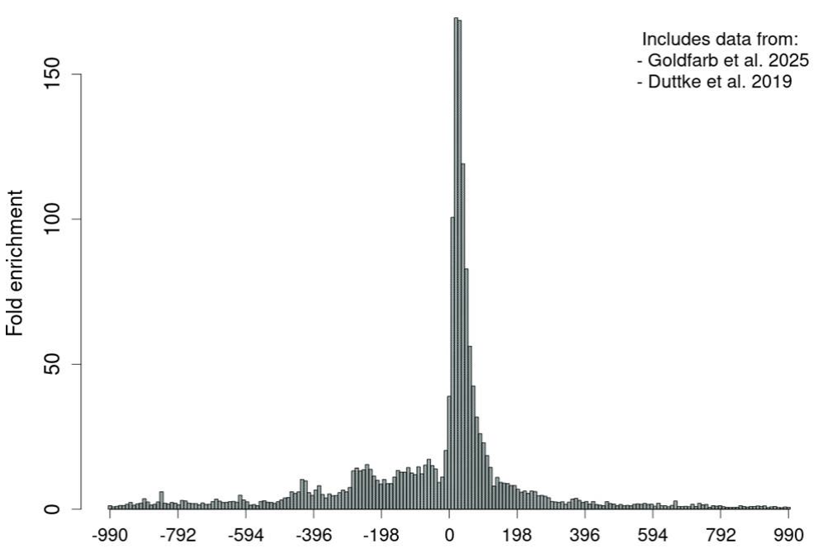
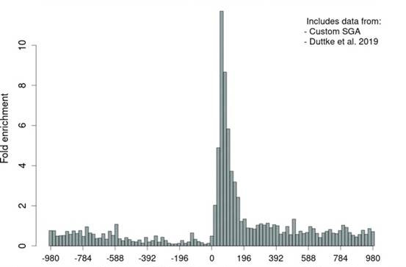
Protein-centric versus DNA-derived annotations
csRNA-seq TSS counts are highly enriched downstream of annotated gene starts from RefSeq
csRNA-seq TSS counts are highly enriched downstream of NFYA binding motifs
Challenge rule:
Usage of RefSeq gene annotation for test sequences at prediction time is not allowed.
Challenge rule:
Inclusion of a motif finder module in TSS prediction pipeline is allowed.

Slide 12
Timeline
Starts now: Sep 4, 2026
Ends on : Nov 30, 2026 (final submission date)
A decision will be taken before Nov 30 whether the challenge will be extended.
In case of an extension,
  New disciplines with different rules may be introduced
  The challenge under the current rule will continue

